Slide 1


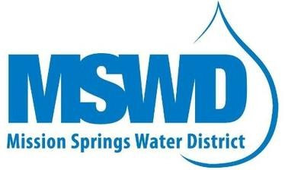


2027 Mission Creek Subbasin Alternative Plan Update Kickoff
WORKSHOP #1
October 29, 2025
1

Slide 2
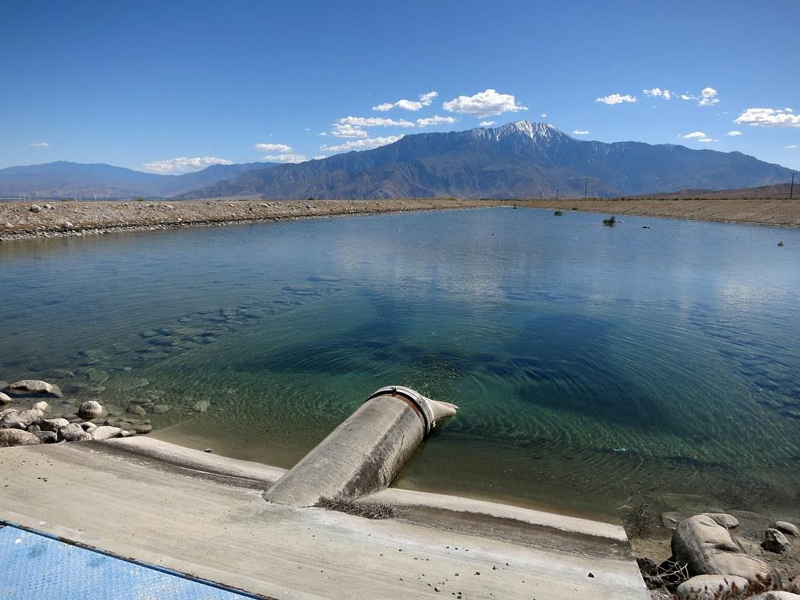
Agenda
Introductions
Overview of Sustainable Groundwater Management Act (SGMA)
Water Management Planning in Mission Creek Subbasin (MCSB)
Sustainable Management Criteria
Supply and Demand Projections
Groundwater Model Forecasts
Periodic Evaluation
Alternative Plan Update
Next Steps
Public Comment
Insert Picture

Slide 3
Introductions

Slide 4
Alternative Plan Update Team
MCSB Management Committee
Coachella Valley Water District (CVWD)
Desert Water Agency (DWA)
Mission Springs Water District (MSWD)
MCSB Consultant Team
WSP USA Inc.
Rincon Consultants, Inc.
Maddaus Water Management Inc.

Slide 5
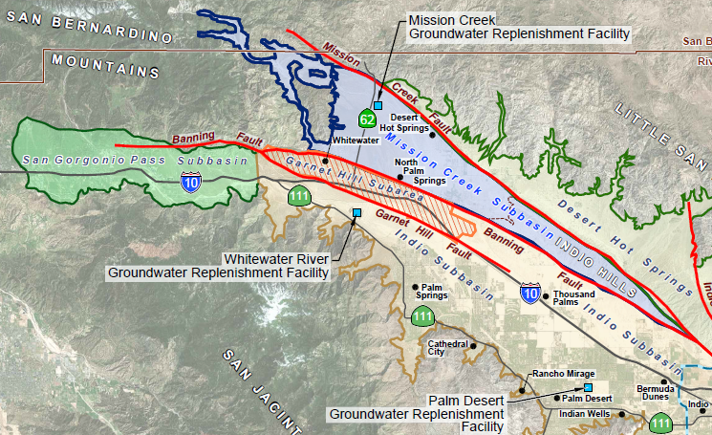
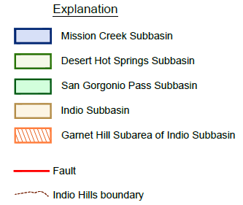
Mission Creek Subbasin
Wedge shape
Fault controlled
Northern area remote mostly federal land
Southern area of Indio Hills consolidated sediments and not populated
Adjacent basins are also managed and partial fault control
Notes:
Northern area US forest service BLM. Whitewater river. Mention groundwater replenishment facility

Slide 6
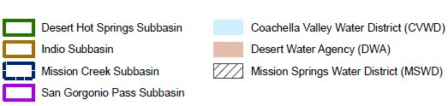
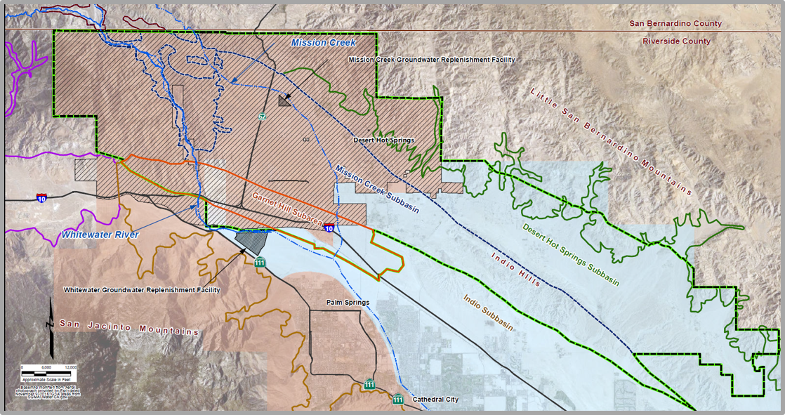
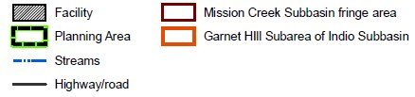
Mission Creek Subbasin

Slide 7
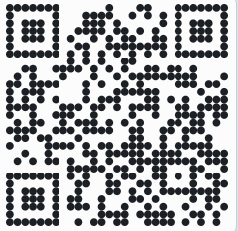
POLL Question #1
Scan the QR Code:
Please identify who you represent:
  General public
  Planning agency
  Water agency
  Business
  Tribe
  Consultant
  Other
Code: Subbasin
Notes:
Let’s start with a quick poll to understand who’s in the room. Please scan the QR code and enter the code “Subbasin.” Select the category that best describes your affiliation—whether you’re a stakeholder/member of the public, a water agency, a tribal representative, a business, or another stakeholder. This helps us tailor future outreach and engagement.

Slide 8
Overview of SGMA
Notes:
RICK

Slide 9
What is SGMA?
SGMA: Sustainable Groundwater Management Act
Signed into law in September 2014
Provides framework for sustainable groundwater management over 20 years
Supports local management via Groundwater Sustainability Agencies (GSAs)
SGMA Requirements
GSAs must submit plans (Groundwater Sustainability Plan or Alternative Plan) and annual reports to the California Department of Water Resources (DWR), and demonstrate progress towards achieving sustainable management
GSP or Alternative Plan updates due every 5 years
First MCSB Alternative Plan update due by January 1, 2022
The Mission Creek Subbasin Alternative Plan Update is due January 1, 2027

Slide 10
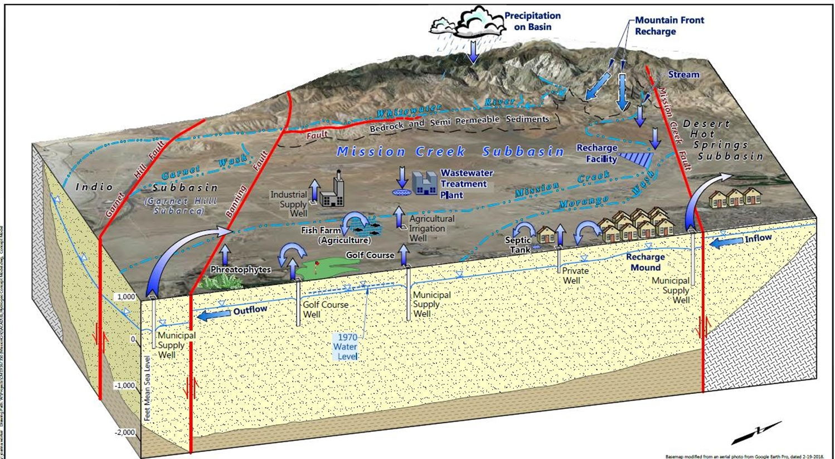
What is Sustainable Management?
The management and use of groundwater in a manner that can be maintained during the planning and implementation horizon without causing undesirable results

Slide 11






Why Do We Need Sustainable Management?
Without Sustainable Management, Issues Can Arise…
Groundwater Level Declines
Groundwater Storage Reductions
Land Subsidence
Interconnected Surface Water Depletions
(Not Applicable in the Mission Creek Subbasin)
Seawater Intrusion
(Not Applicable in the Mission Creek Basin)
Water Quality Degradation

Slide 12







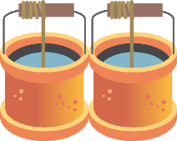

What is a GSA?
GSA: Groundwater Sustainability Agency
Consists of one or more local governmental agencies that implement the provisions of SGMA
Formation of a GSA is required in high- and medium-priority basins – MCSB is a medium priority basin
Basin Priority is Based On:
Total Population
Population Growth
# of Public Wells
# of Total Wells
Irrigated Acreage
Groundwater Reliance
Groundwater Impacts
Other Adverse Impacts
Notes:
DAVID
Responsible for achieving sustainable groundwater management within their boundaries
A GSA, or multiple GSAs, are responsible for:
Submitting Groundwater Sustainability Plans (GSPs) or Alternative Plans
Preparing Annual Reports and 5-Year Plan Updates
GSAs have many authorities and responsibilities, such as:
Adopting rules, regulations, ordinances, and resolutions to implement the Act
Monitoring compliance and enforcement
Requiring registration of groundwater extraction wells
Requiring appropriate measurement devices and reporting of extractions

Slide 13
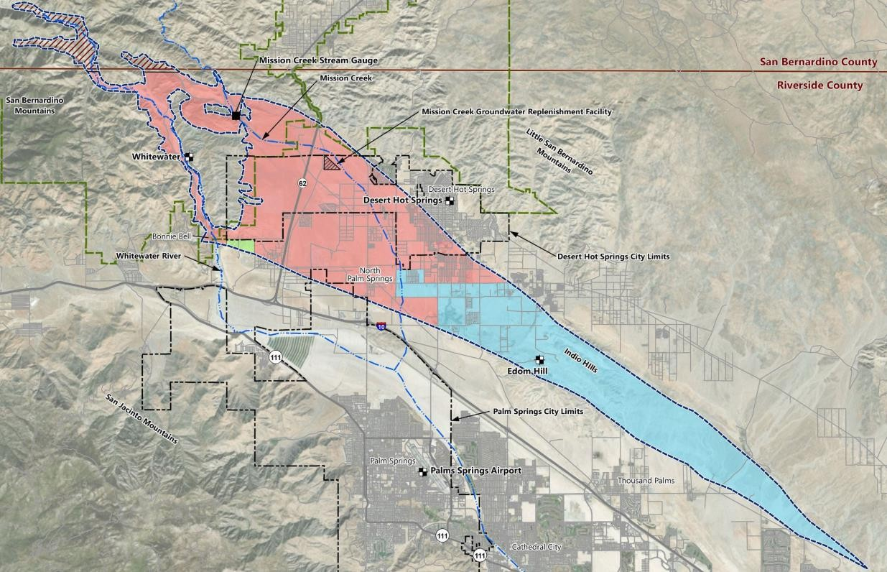
GSAs in the MCSB
GSAs include:
CVWD
DWA
Management Committee includes:
CVWD
DWA
MSWD
DWA: GSA
Exclusive Area
CVWD: GSA
Exclusive Area
Source: https://cvwd.org/504/Mission- Creek-Subbasin-SGMA-Compliance
16
Notes:
RICK

Slide 14
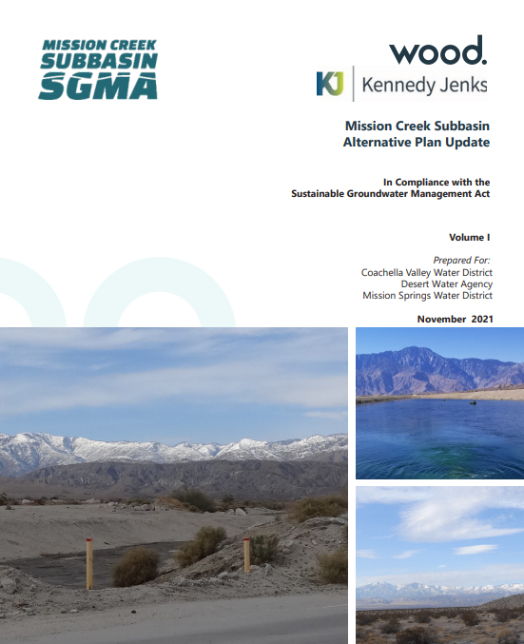
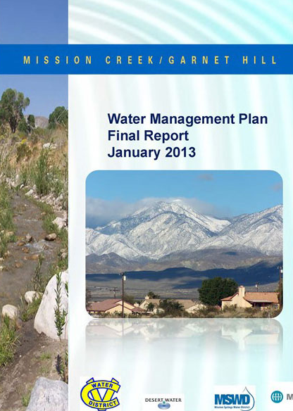
What is a GSP, Alternative Plan, & Alternative Plan Update?
GSP: Groundwater Sustainability Plan
Long term plan addressing how to sustainably manage groundwater
Required for high- and medium-priority basins
Alternative Plan
A functionally equivalent alternative submittal to a GSP
Shares goal of GSP to achieve groundwater sustainability
Periodic Evaluation
GSAs must submit periodic evaluations at least every five years to demonstrate progress toward basin sustainability and compliance with their GSPs/Alternative Plans.
Alternative Plan Update
An updated Alternative Plan if directed in the DWR-required Periodic Evaluation

Slide 15
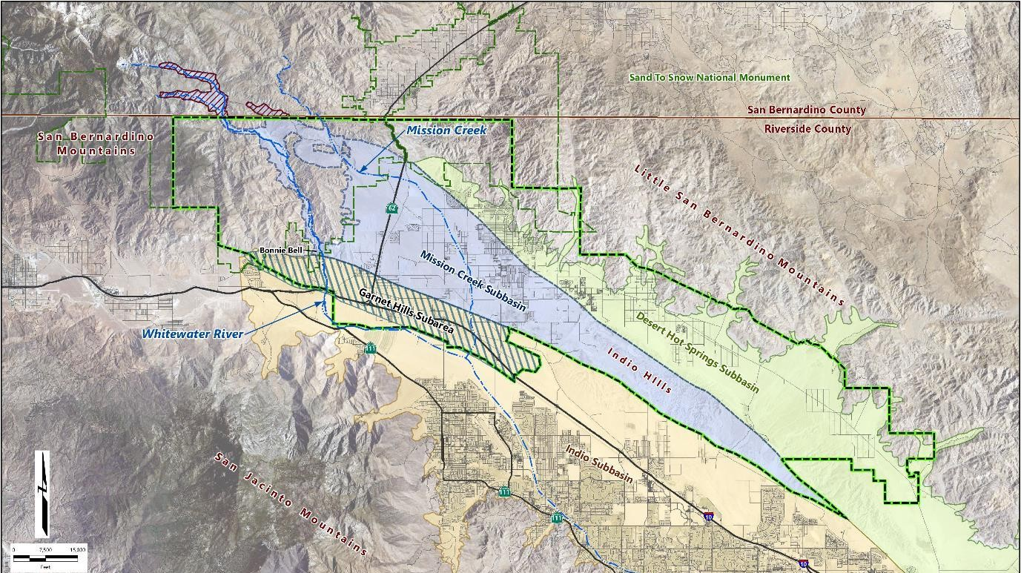
Mission Creek Subbasin Planning Area
Planning area boundary includes areas where water from MCSB could be used
Desert Hot Springs
Mission Creek Subbasin
Planning Area
Palm Springs
Notes:
Notes
MCSB Water Management Plan created in 2013
The Water Management Plan in addition to the Bridge Document was approved by DWR as an Alternative Plan for the MCSB
Management Committee to utilize several management tools to achieve sustainability goals
Garnet Hill Subarea included in both MCSB and Indio planning efforts. Annual reporting is done as part of Indio Subbasin Annual Report

Slide 16




Water Management and SGMA Timeline for MCSB
Groundwater recharge begins in Mission Creek Subbasin based on over 25 years of prior planning efforts
Settlement Agreement leads to Management Committee formation
SGMA Bridge Document created; submittal of WMP and Bridge Document to DWR
Mission Creek Subbasin Alternative Plan Update
2002
2003
2004
2013
2016
2019
2022
2024
2025-2027
DWR approves Alternative Plan Update
Mission Creek/Garnet Hill Water Management Plan
DWR approves Alternative Plan for Mission Creek Subbasin
Mission Creek Groundwater Replenishment Agreement between CVWD and DWA
Alternative Plan Update
*In Progress"
January 1, 2027
Submit Final Alternative Plan Update to DWR
Assess 2022 Alternative Plan Update Approved by DWR in 2024
Conduct Stakeholder and Public Outreach
(Ongoing)
Draft 2027 Alternative Plan Update and Periodic Assessment

Slide 17
POLL Question #2
Please identify your interest in the Alternative Plan Update
(can choose more than one):
  Conservation
  Water quality
  Well pumping
  Groundwater replenishment
  Recycled water
  Imported water
  Drought
  Other:
Scan the QR Code:
Code: Subbasin
Notes:
Now we’d like to understand your interests in the Alternative Plan Update. Again, scan the QR code or visit the link and enter the code “Subbasin.” You can select multiple interests, such as conservation, water quality, groundwater replenishment, recycled water, drought, or others. Your responses will help us prioritize topics and concerns in future workshops.

Slide 18
Water Management Planning in the Mission Creek Subbasin

Slide 19
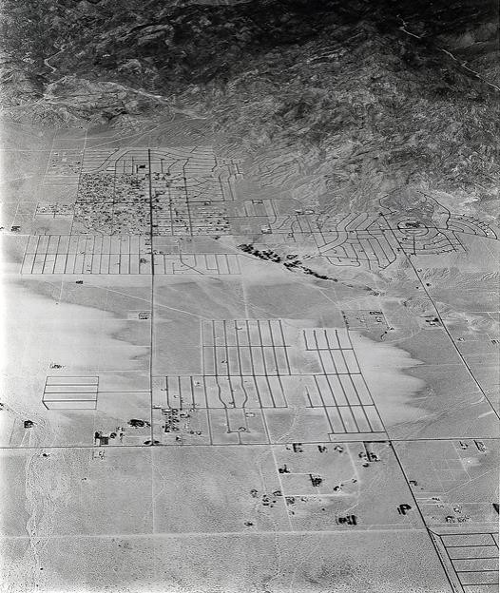


Historical Water Needs in the MCSB
The discovery of mineral water in the Desert Hot Springs Subbasin and drinking water in the MCSB led to increased tourism
The establishment and population growth of Desert Hot Springs led to the creation of MSWD in 1953
As population in Desert Hot Springs grew, water demands also grew, leading to a decrease in groundwater levels until management was implemented
  Population 1960: 1,472
  Population 2000: 16,582
  Population 2020: 35,512
Sources: https://www.dhshistoricalsociety.org/times-past; https://en.wikipedia.org/wiki/Desert_Hot_Springs,_California#cite_note-DecennialCensus-28; Profile of the City of Desert Hot Springs (SCAG, 2020)
Aerial view of Desert Hot Springs, 1954
25
Notes:
RICK

Slide 20
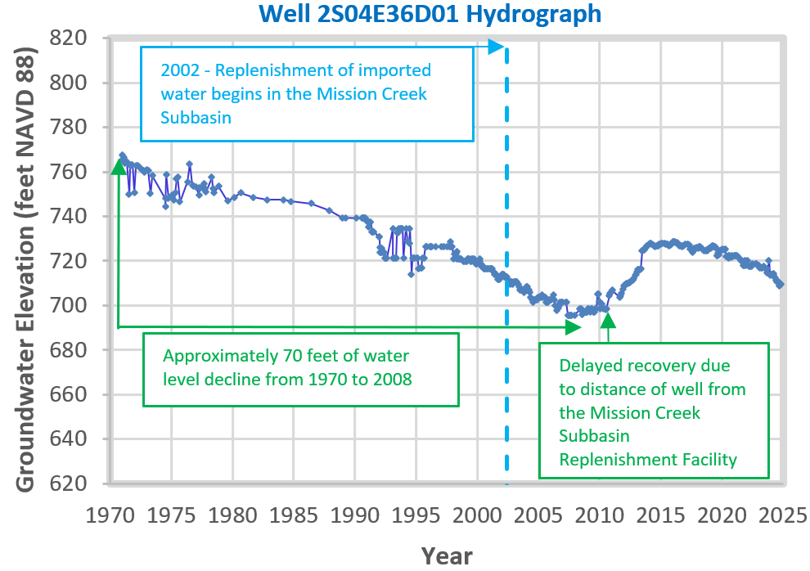
Why Was Management Needed to Begin With?
Groundwater levels steadily declined as water use increased with population
Management actions were needed to avoid undesirable results potentially caused by a continued decline in water levels (e.g., increased pumping cost, reduction in storage, and land subsidence)
Active management creates positive results

Slide 21
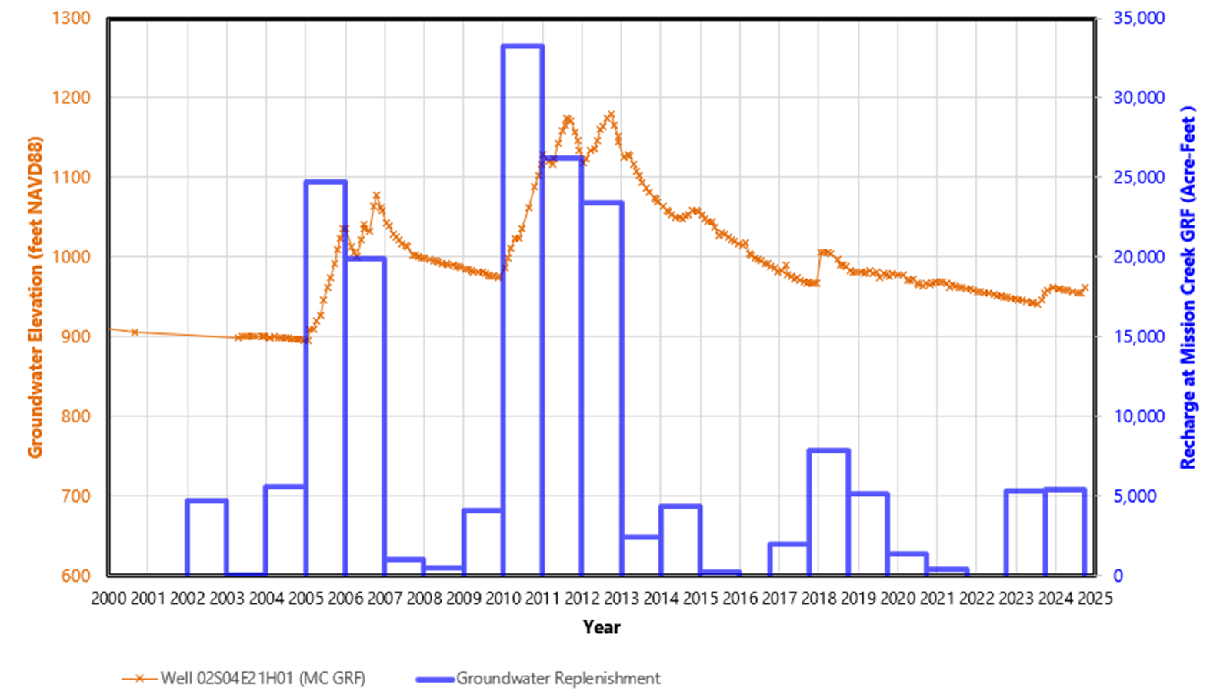
Water Management Agencies Acted Before SGMA
Constructed Groundwater Replenishment Facility in the northwestern part of the MCSB
Groundwater replenishment began in 2002
Over 250 feet of water level increase at the Replenishment Facility in 2011 and 2012

Slide 22
Sustainable Management Criteria (SMC)

Slide 23

Why Do We Need Sustainable Management?
Without Sustainable Management, Issues Can Arise…
Groundwater Level Declines
Groundwater Storage Reductions
Land Subsidence
Interconnected Surface Water Depletions
(Not Applicable in the Mission Creek Subbasin)
Seawater Intrusion
(Not Applicable in the Mission Creek Basin)
Water Quality Degradation

Slide 24
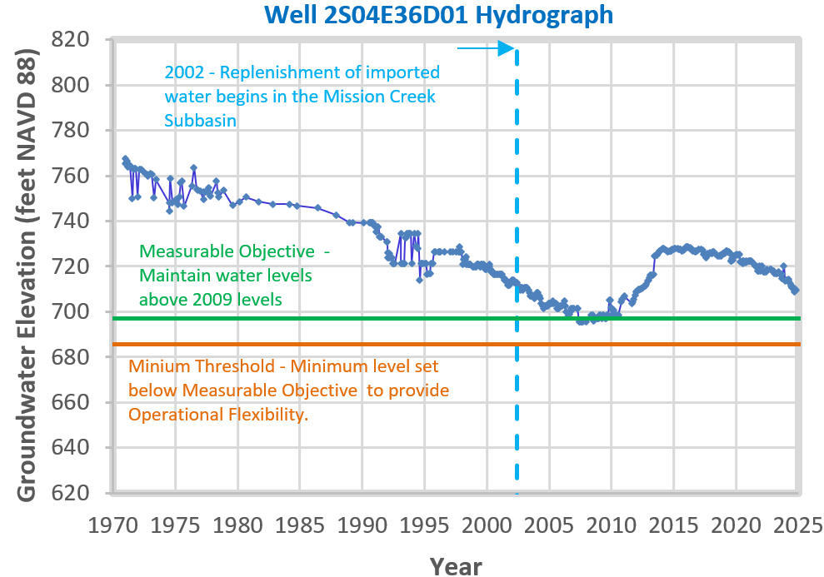
Sustainable Management Criteria– Water Level and Storage
No undesirable results were identified in the MCSB other than persistent historical water level declines and storage reductions that have since been reversed
Use water levels as an indicator (proxy) for storage
Measurable Objective - maintain groundwater levels at or above 2009 levels
Minimum Threshold - set at levels that will not impact well pumping operation
Operational Flexibility - operations between Measurable Objective and Minimum Threshold
Temporary and localized exceptions - allow for water levels to drop below the Minimum Threshold temporarily in some wells

Slide 25
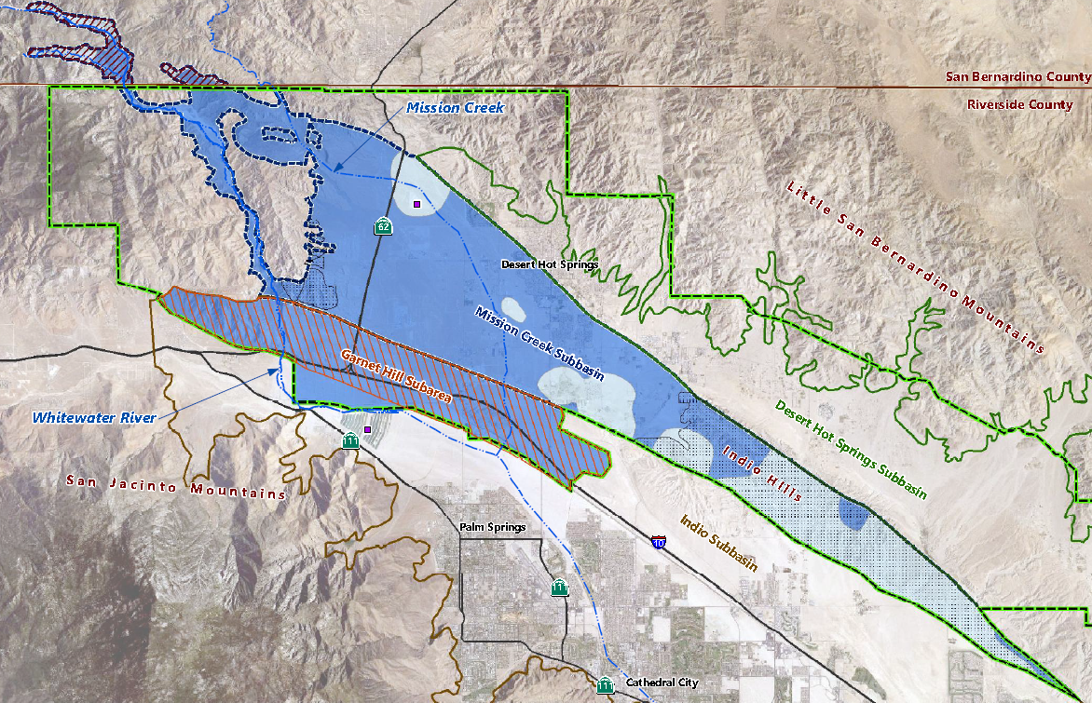

Sustainable Management Criteria– Subsidence
A small rise and drop in ground level (GL) from 2015 to 2019
Active faulting in the area may play a role
Non-permanent changes in GL may occur from water level changes and is not an undesirable result
Water levels may be used as a proxy for subsidence monitoring
Continue to use DWR monitoring of subsidence
USGS study in progress to help assess
Vertical Displacement (feet)
0 to -0.25 - Rise in ground level
0 to 0.25 - Drop in ground level
-0.25 to 0 - Rise in ground Level
Notes:
MK: What does the first bullet mean? 4th bullet: No indication that it is a good proxy here. Response – subsidence occurs when water levels drop below historical levels. Water levels above the 2009 level is good proxy that subsidence will not occur

Slide 26
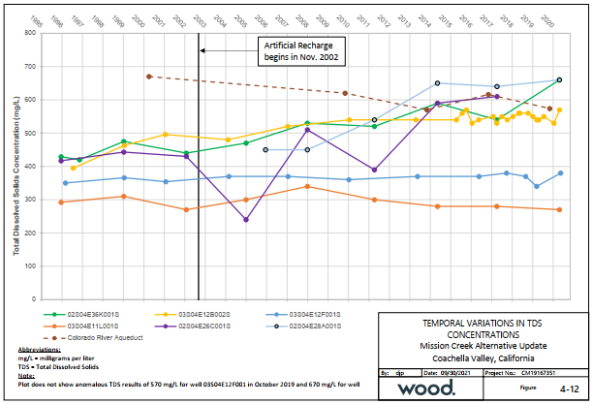
Sustainable Management Criteria- Water Quality Degradation
No exceedance of water quality thresholds (e.g., State Maximum Contaminant Levels [MCLs] for drinking water) were identified
Total Dissolved Solids (TDS) was noted to be increasing in parts of the MCSB
TDS and Nitrate will be addressed on a regional scale as part of the Coachella Valley Salt and Nutrient Management Plan (in progress).
Notes:
978

Slide 27
Next Steps
Compile sustainable management criteria (SMC) data from the last five years
Evaluate the trends and compare these against the SMCs for water levels, ground level changes, and water quality
Recommend modifications to the SMCs if needed and additional areas to collect data if data gaps are identified

Slide 28
Supply and Demand
Projections
Notes:
KAT/ROSALYN

Slide 29
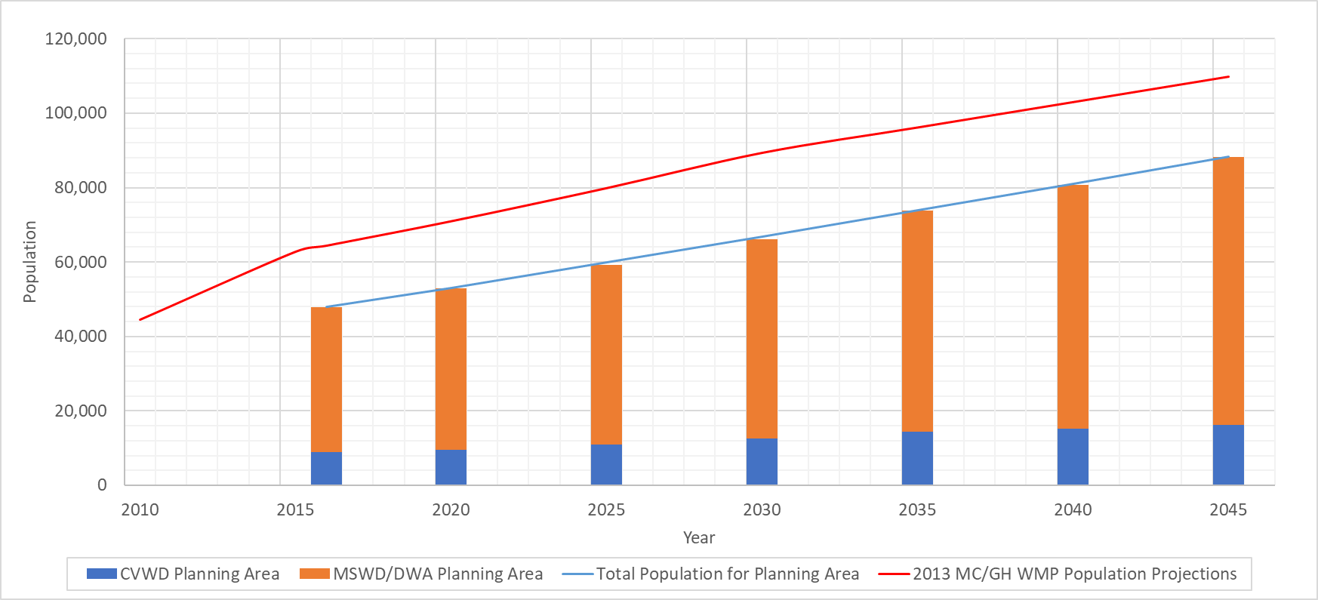
Population Projections
Population Growth in 2022 Alternative Plan Forecast

Slide 30
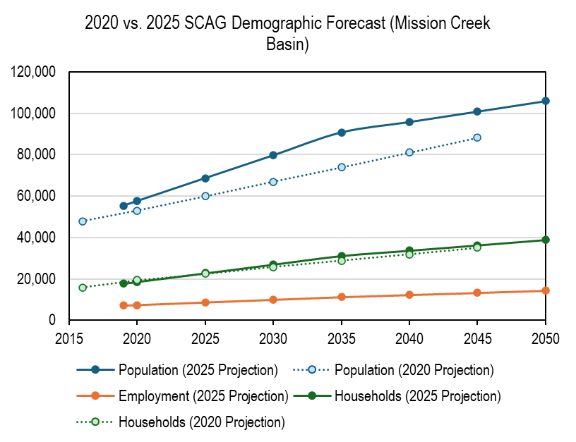
Population Projections - Update
Southern California Association of Governments (SCAG) population projections for the Planning Area indicate an increase from about 58,000 in 2020 to about 106,000 in 2050
Projected population in 2045 is greater than estimated in the 2022 Alternative Plan Update
Projected household numbers are similar to the estimates in the 2022 Alternative Plan Update
Notes:
SCAG 2045 pop = 88,310
WMP 2045 pop = 109,793

Slide 31
Demand Projections
Historical
Water Use
Demand Factors
Demand Projections
Demographic Projections

Slide 32
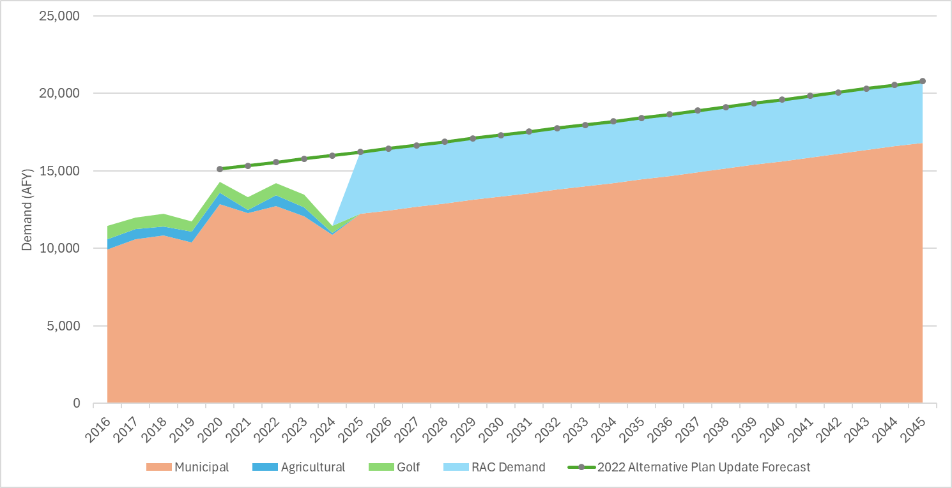
2022 Demand Projections
2016-2024 Water Use & 2022 Alternative Plan Forecast
Actual
Forecast

Slide 33
Water Supplies
Potential Supply
State Water Project
Groundwater
Recycled Water

Slide 34
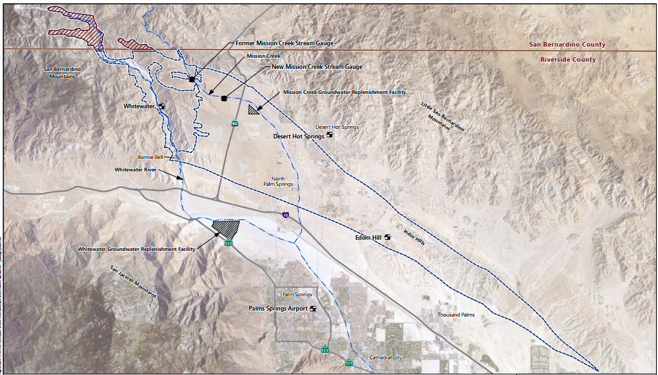
Water Supplies

Slide 35
Projected SWP Deliveries to the MCSB Replenishment Facility
Allocation of SWP deliveries to the MCSB is projected to increase from 8% in 2020 to 10% by 2045 based on increasing demand projections for the MCSB relative to Whitewater River Subbasin Management Area
By 2045, the additional SWP supplies from the new projects (improved Delta reliability and Sites Reservoir) are projected to provide 5,393 AFY of additional water to the MCSB

Slide 36
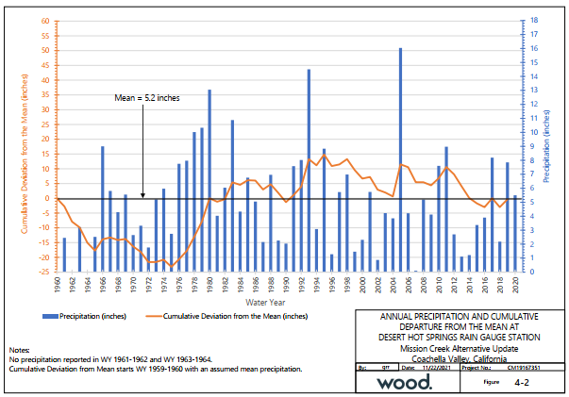
Next Steps
Continue to update demand forecast:
  Incorporate historical demand data
  Refine future demand factors
  Incorporate conservation measures
Update supply forecast:
  Incorporate historical supply data
  Refine anticipated future water supply availability
  Evaluate any water supply gaps

Slide 37
POLL Question #3
Which conservation actions have you participated in?
  Installing a low-flow showerhead
  Installing a low-flow toilet
  Installing an energy efficient washer/dryer
  Installing greywater system (washers, sinks, showers) for irrigation
  Irrigation management (e.g. weather-based controllers, landscape watering guidelines)
  Replacing landscaping with drought-tolerant plants
  Attending workshops about water conservation and drought
Scan the QR Code:
Code: Subbasin
Notes:
Let’s talk about conservation. Which conservation actions have you already taken? Examples include installing low-flow fixtures, using drought-tolerant landscaping. Please scan the QR code and let us know what you’ve done, and what you’re open to doing. This helps us understand community engagement and potential for future conservation programs.

Slide 38
Groundwater Model
Forecast
Notes:
ALEXIS and DAVE

Slide 39
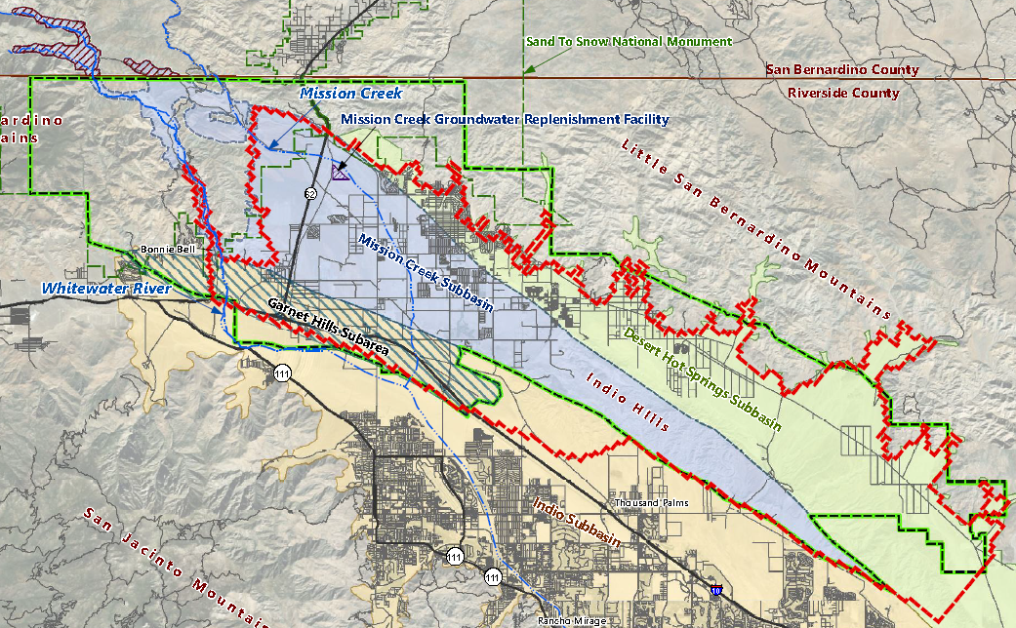
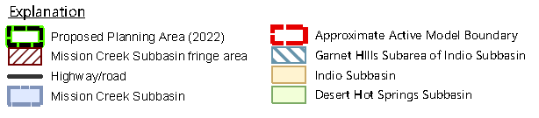
Mission Creek Subbasin Groundwater Model
Computer simulation of groundwater (occurrence, flow, recharge, pumping, etc.)
Updated for the planning area
Coordinated boundary conditions with the groundwater model in the Indio Subbasin
84-year simulation 1936 to 2019
Model Domain Boundary
Planning Area
Notes:
DAVE to present groundwater details groundwater flow and occurrence, pumping, return flows, natural recharge, and artificial recharge in the Planning Area
SL: be consistent with title case and sentence case throughout

Slide 40
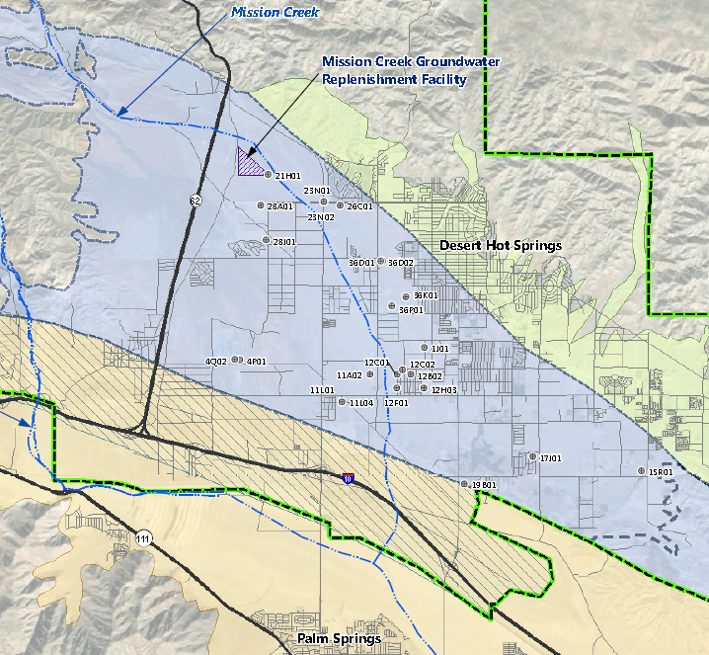
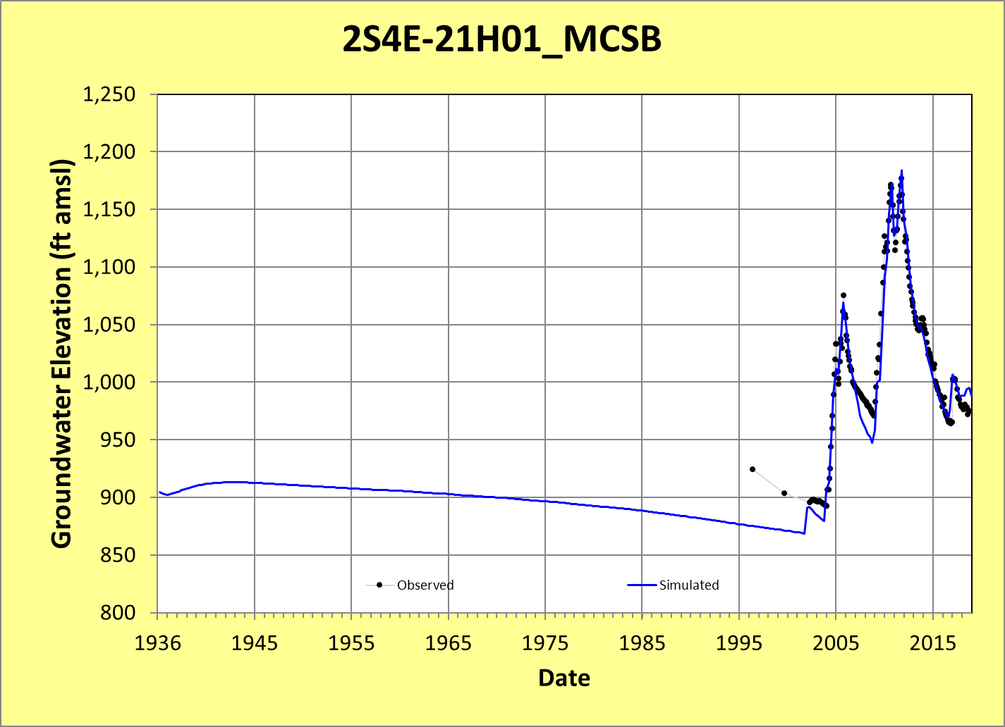
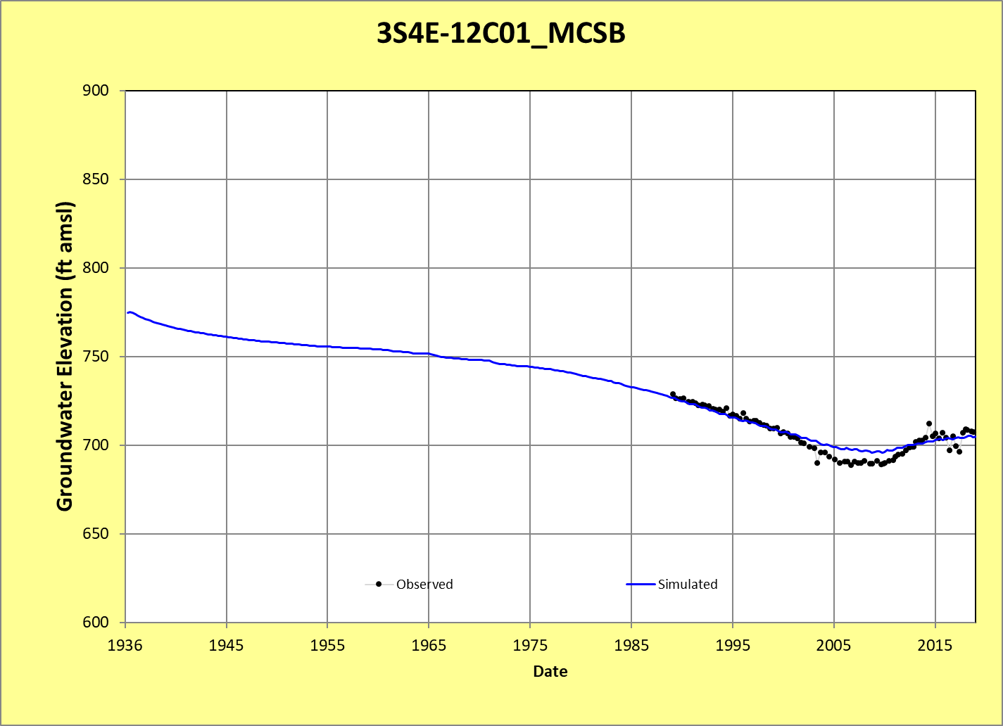
Groundwater Model Previously Updated to 2019 & Calibrated

Slide 41
Water Management Forecasts
Scenarios focus on drier hydrologic conditions more typical of the past 20 years (“climate change”) with longer-term historical average hydrology shown for comparison as a Baseline
Both historical average and climate change scenarios use SWP deliveries of 45% based on past 14 years and potential for ongoing impacts from legal, environmental, and drought factors
Baseline assumes historical local hydrology (precipitation, runoff, and recharge) from 1970 to 2019 for the 50-year forecast with average natural recharge of about 21,400 AFY
Climate change scenarios
  Local hydrology based on continuation of a 25‑year period of below normal precipitation from 1995 through 2019 for two cycles (50 years total) with average natural recharge of about 12,700 AFY
  1.5% decrease in SWP Table A deliveries by 2045 (based on DWR forecast)

Slide 42
Forecast Scenarios
Baseline Scenario
Near-Term Projects Scenario
Future Projects Scenario
Construction of Regional Water Reclamation Facility (RWRF) in Garnet Hill Subarea
Conveyance of a portion of wastewater from the MCSB to the RWRF for treatment
No return of RWRF-recycled water to the MSCB
No new supplies or increased SWP reliability for replenishment
Lake Perris Seepage Recovery Project brings additional SWP water beginning 2023
Recycled water from the RWFR is conveyed back to the MCSB for recharge or non-potable reuse
Includes near-term projects noted above and
Sites Reservoir Project brings additional SWP water beginning 2035
Delta Conveyance Project increases SWP reliability beginning 2045

Slide 43
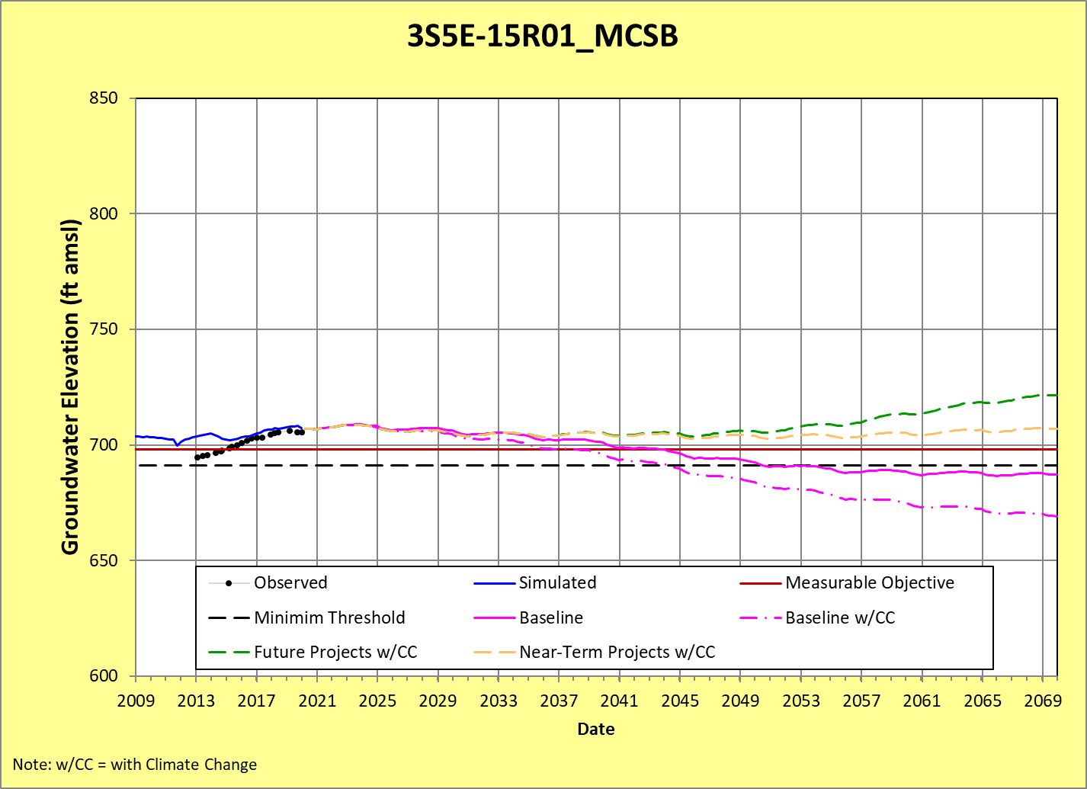
Forecast Findings for Groundwater Levels
Planned projects are expected to increase SWP supply and reliability for replenishment and allow for ongoing sustainability in the MCSB even under conservative climate change assumptions

Slide 44
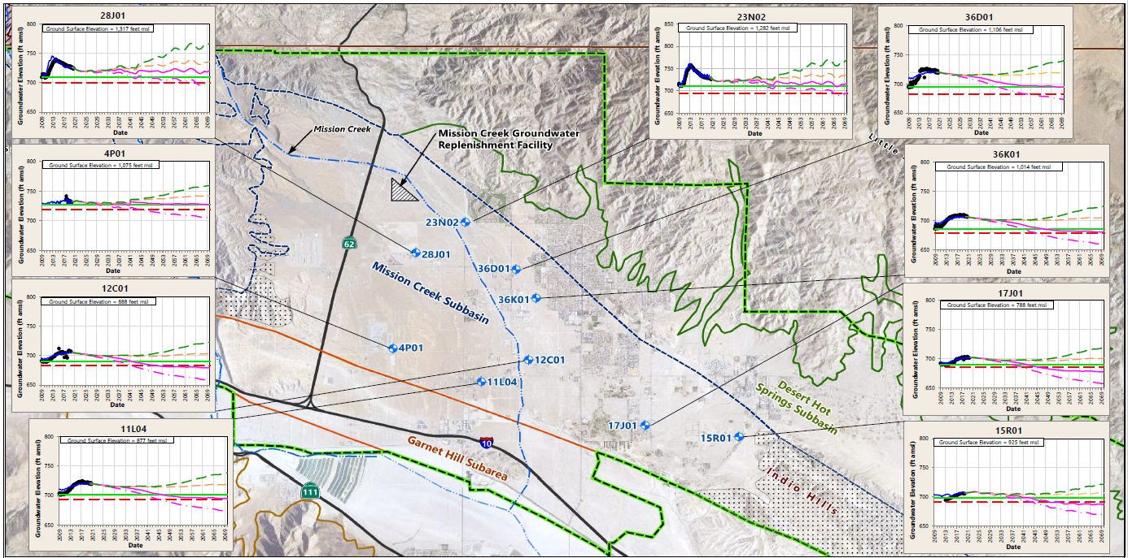
Scenario Forecast for Key Wells

Slide 45
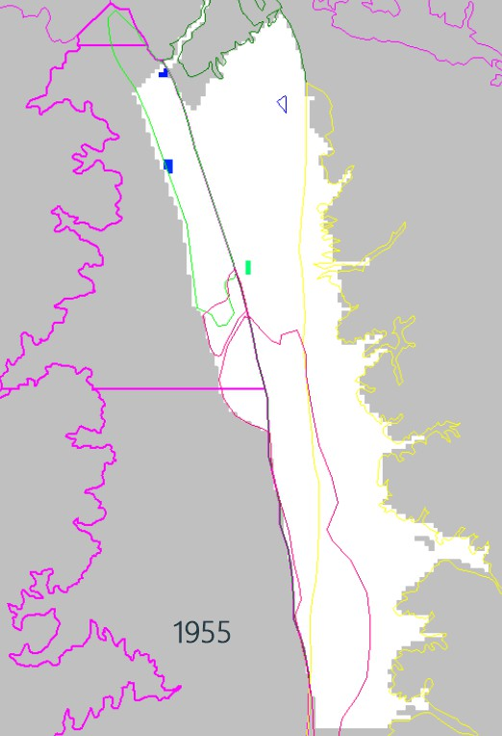
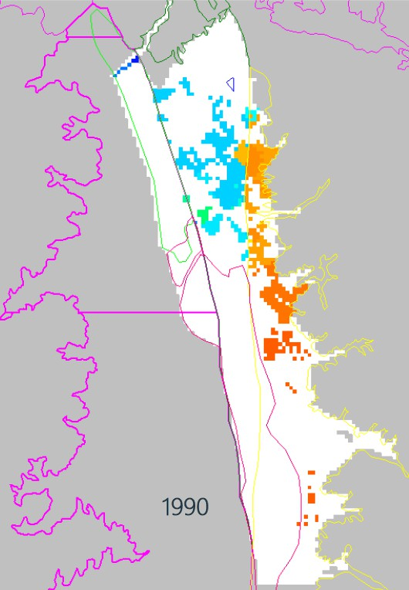
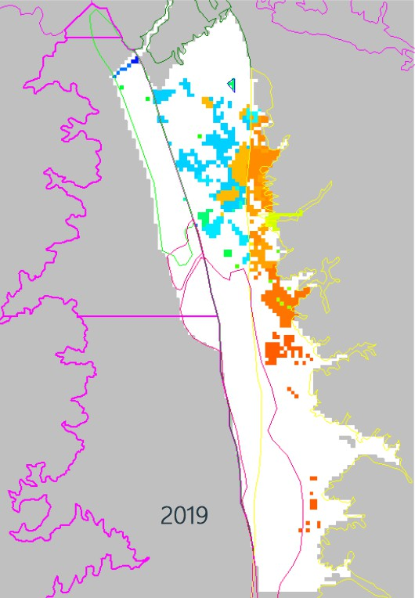
Next Steps – Update Model Through WY23/24
Compile the last five years of data (water level, recharge, pumping, precipitation, etc.)
Update the existing groundwater model with the new data
Update scenarios with assumed future hydrology including climate change using Global Climate Change models (GCMs) by USGS and others
Update scenarios with current planned project and management actions
Run scenarios to confirm continued sustainability into the future

Slide 46
Periodic Evaluation

Slide 47

Periodic Evaluation
Periodic Evaluation shall describe whether the Plan implementation, including implementation of projects and management actions, are meeting the sustainability goal in the basin.
Compilation of growth and water demand data from WY 2020-2024 for comparison against the 2022 Plan demand forecast
Review of current groundwater conditions for each sustainability indicator relative to the measurable objectives (MOs) and minimum thresholds (MTs)
Description of the monitoring network within the basin, including whether data gaps exist
Description of significant new information and whether new information warrants changes to any aspect of the Plan

Slide 48
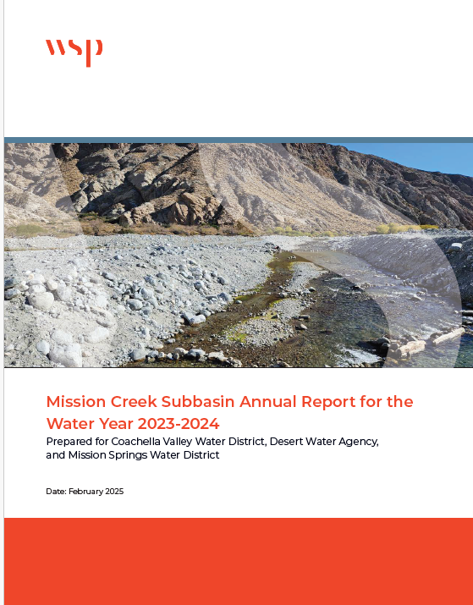
Annual Reports
Completed each year in accordance with SGMA to summarize groundwater conditions and the status of implementation of Projects and Management Actions in the Alternative Plan
Documents groundwater use
Conducts a groundwater balance (inflows vs outflows) and calculates the change in storage
Provides a summary of the sustainable management criteria for groundwater levels, groundwater storage, subsidence, and groundwater quality
Provides an update on objectives met and progress toward achieving the water management objectives outlined in the Alternative Plan update

Slide 49
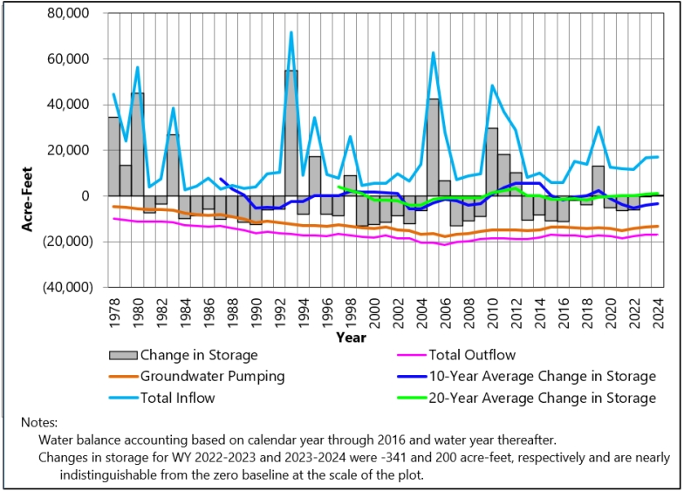
Is the Alternative Plan Working?
2002: refill begins and reducing deficit GW storage
2005: first annual surplus in GW storage in decades stabilizes due to conservation efforts
2006: GW production begins decline
2009: the 10-year average change in storage shows net increase
2019-2024: water inflow stabilizes and minimal change in storge
Sustainable management works!
GW- Groundwater*
Source: Mission Creek Subbasin Annual Report for WY 2023-2024
Notes:
FINAL MCSB Annual Report for WY 2023-2024.pdf

Slide 50
Mission Creek Subbasin Alternative Plan Update

Slide 51
Questions to be Answered in Alternative Plan Update
Are projections of population growth and water use/demand from 2022 still valid?
What new factors/conditions could affect future water demand and supplies?
What is the current status of groundwater conditions and are we meeting the thresholds?
What is the status of existing management actions? And are there any new actions to consider?
Is the current Plan implementation schedule appropriate?
What goals and criteria are appropriate to define groundwater sustainability?

Slide 52
Tasks to Prepare the 2027 Alternative Plan Update
Assess the existing Alternative Plan
Update population projections, water demand, and supply assumptions
Update the groundwater model with recent 5 years of pumping, recharge and water level data and check calibration
Evaluate and if needed update the Management Actions
Update the groundwater model forecast using the updated model, water demand and supply assumptions, and management actions
Evaluate sustainable management criteria for undesirable results based on the groundwater model forecast.
Assess data collection/monitoring programs

Slide 53
POLL Question #4
My concerns about groundwater and water are:
Water supply reliability
Water quality
Declining levels
Expensive /Water rates
Subsidence (sinking land)
Conservation
Drought
Recycled water
Drinking Water Quality
Other
Scan the QR Code:
Code: Subbasin

Slide 54
Next Steps

Slide 55
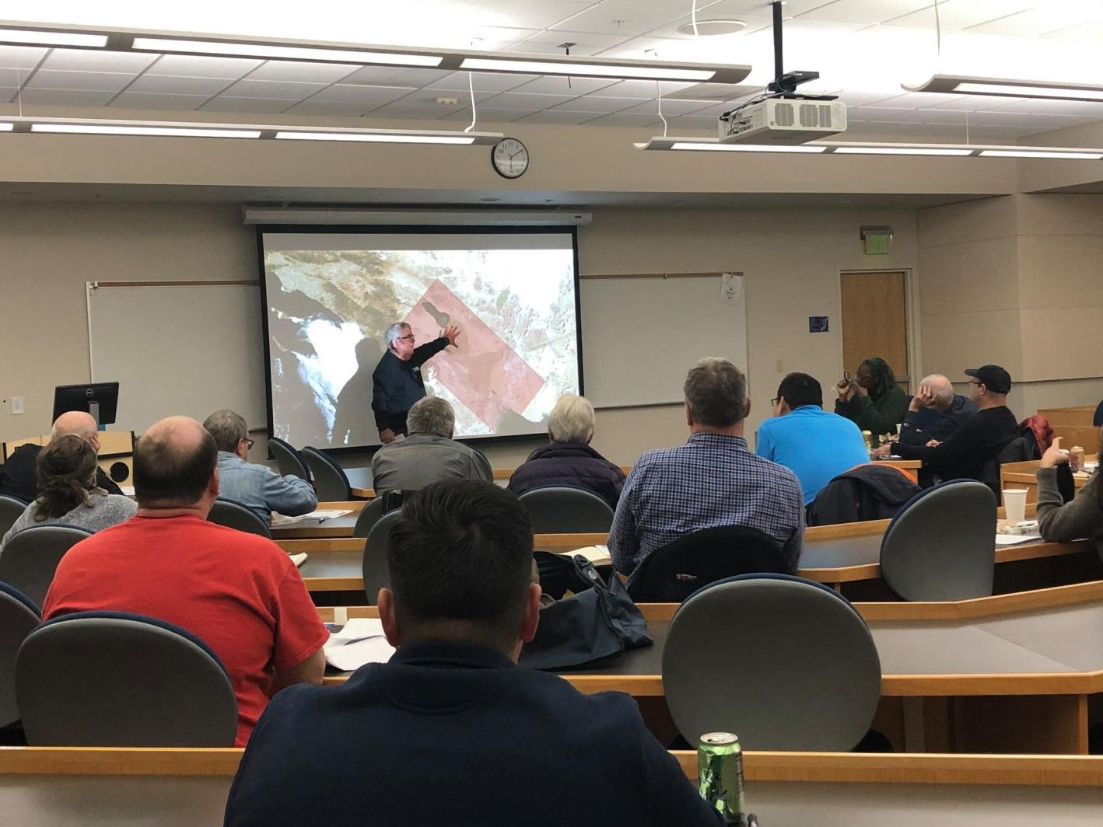
Stakeholder and Public Outreach
Workshops Planned to:
  Share results/findings
  Receive input and feedback
  Next Workshop Spring 2026
Public Comment on Reports:
  Draft report: 45 days to review
  Final report: DWR to post for minimum 60 days public comment following January 1, 2027 Submittal

Slide 56
Topics for Workshop #2
Workshop #2 in March 2026:
Forecast future growth based on land use
Project future water needs
Developing future water supply assumptions
Update groundwater model and begin preparing the forecast
Define scenarios

Slide 57
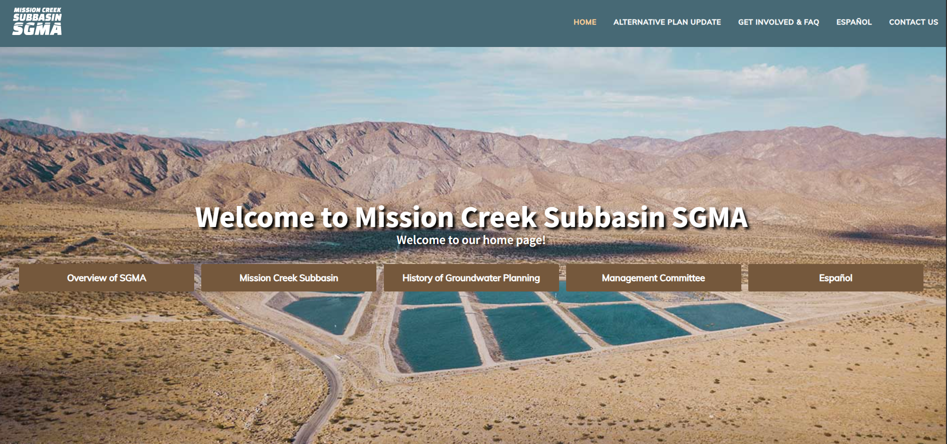
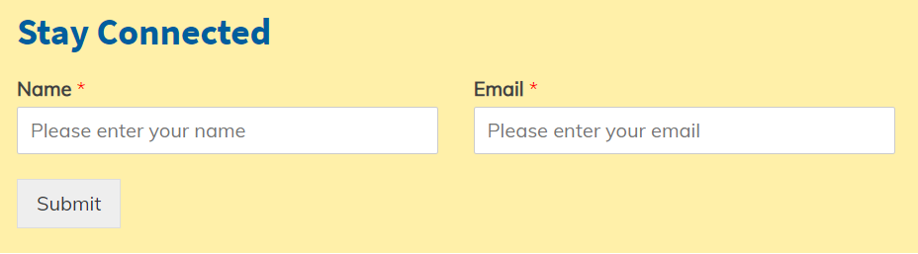
Get Involved
www.missioncreeksubbasinsgma.org/get-involved-faq
For additional information, please contact:
  Rick Rees
  Principal Hydrogeologist, WSP
  richard.rees@wsp.com
info@missioncreeksubbasinsgma.org

Slide 58
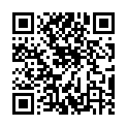
Public Comment
Scan the QR Code!
Notes:
We welcome your comments! Link to Public Comments https://www.surveymonkey.com/r/DTYBFQW

Slide 59

Open Discussion
Questions?
Possible Topics:
  Private wells
  Drought
  Conservation
  Recycling water (future)
  Groundwater questions

Slide 60
Thanks for joining us!

Slide 61
BACKUP SLIDES

Slide 62
Groundwater Simulations
Model used for:
  Simulating groundwater inflows and outflows from the subbasin to estimate groundwater balance (water budgets) and calibrated using water level observations over decades
  Evaluating benefits of management actions by simulating the actions
  Selecting appropriate sustainability goals/criteria
Model inputs include both temporal and spatial variables
Source: MCSB Alternative Plan Model Update 6-16-20

Slide 63
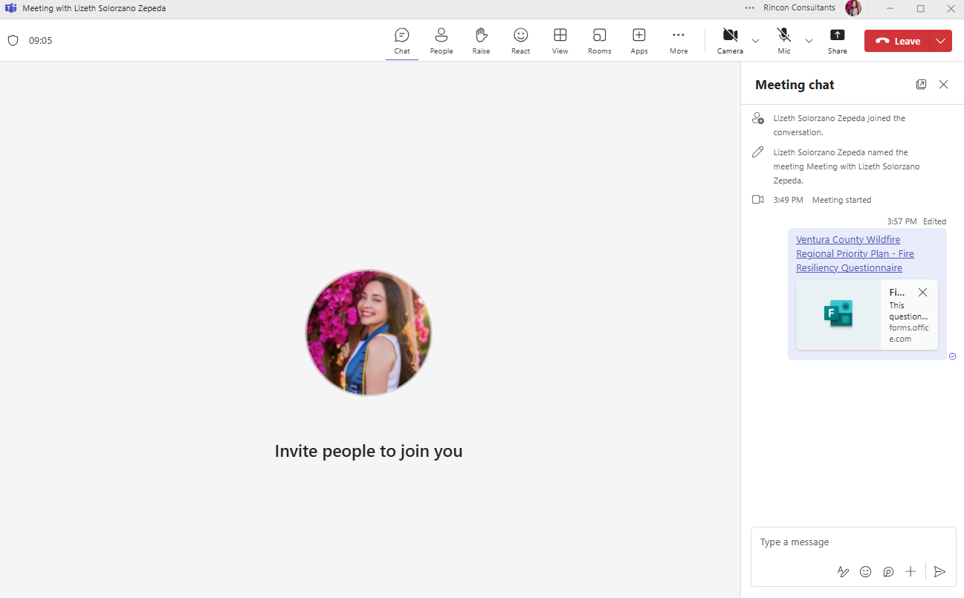
The Virtual Experience: Polls
Sometimes, there will be a link to a poll.
Click on the link

Slide 64

The Virtual Experience: Comments
Click on the comment button to open “Chat” for comments and questions
Type comments or questions here

Slide 65
The Virtual Experience: Raising Hand
“Raise your hand” by
clicking on hand icon

Slide 66
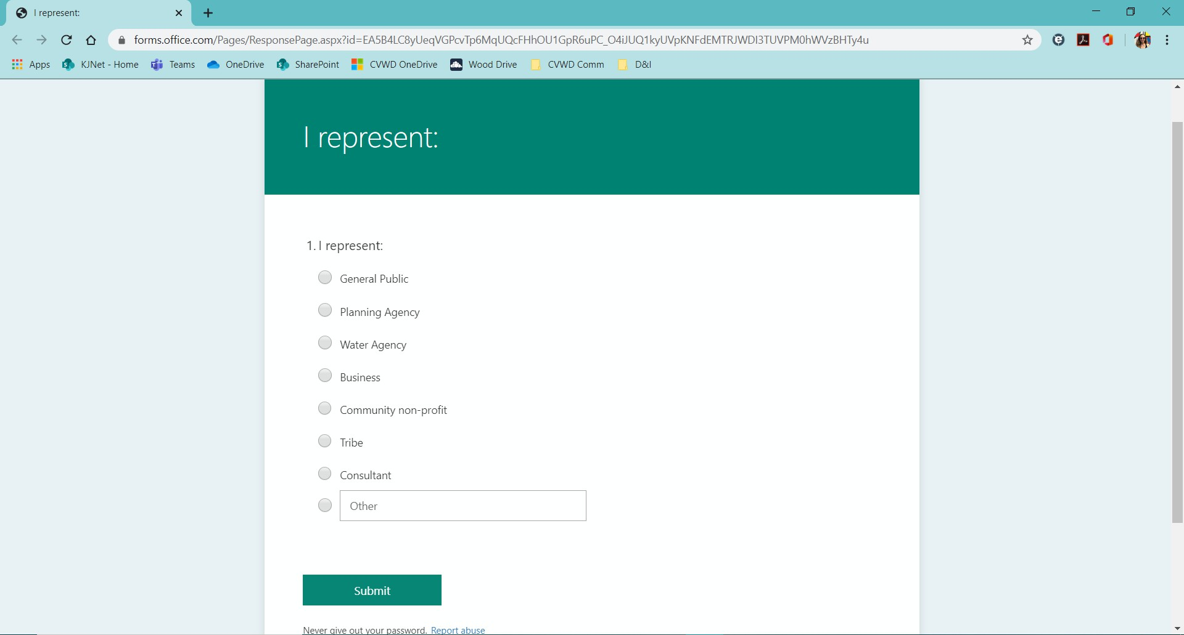
The Virtual Experience: Polls
Fill out the poll and
click “Submit”

Slide 67
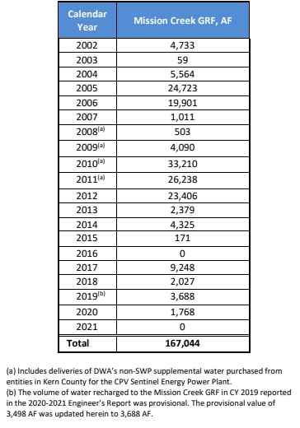
Action: Groundwater Replenishment
Deliveries for Direct Replenishment at Mission Creek Groundwater Replenishment Facility
Mission Creek Groundwater Replenishment Facility
Utilizes imported water to replenish groundwater in the subbasin
Source: 2022-2023 Engineer's Report on Water Supply and Replenishment Assessment, April 2022
Notes:
978

Slide 68
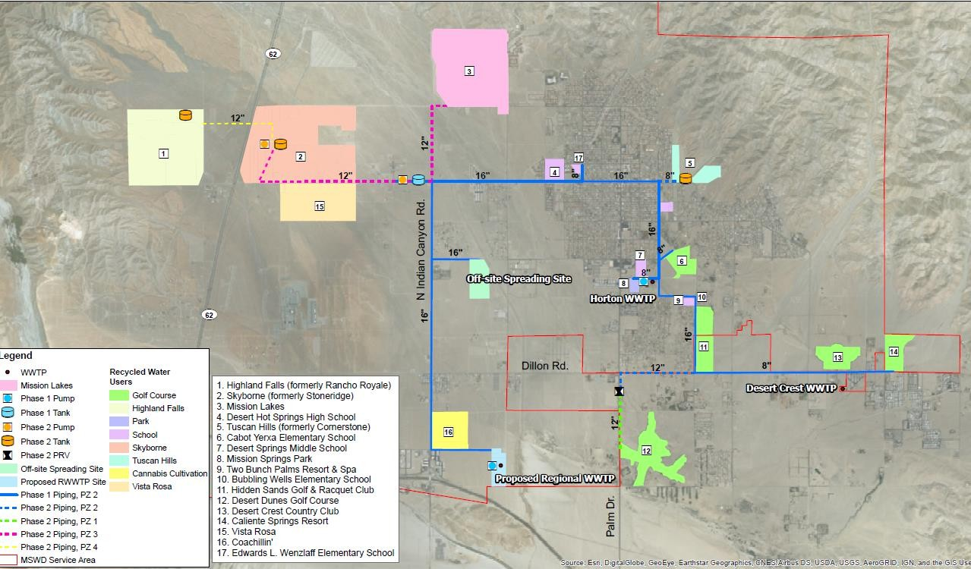


Action: Potential Source Substitution of Non-Potable Water
Recharge Basin Site
Potential Groundwater Recharge Basins
Possible Alternative Non-Potable Sources
  Tertiary treatment to use recycled water for irrigation
  Stormwater capture
Within MCSB
  MSWD: potential 80-acre recharge facility for recycled water or stormwater
Source: MSWD Recycled Water Program Feasibility Study (2018)
30

Slide 69
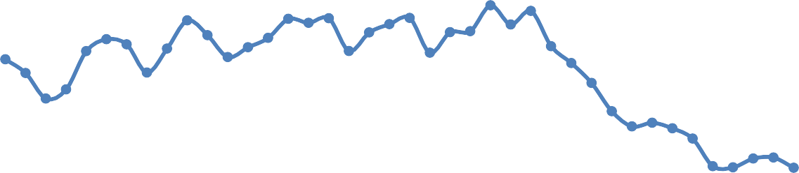
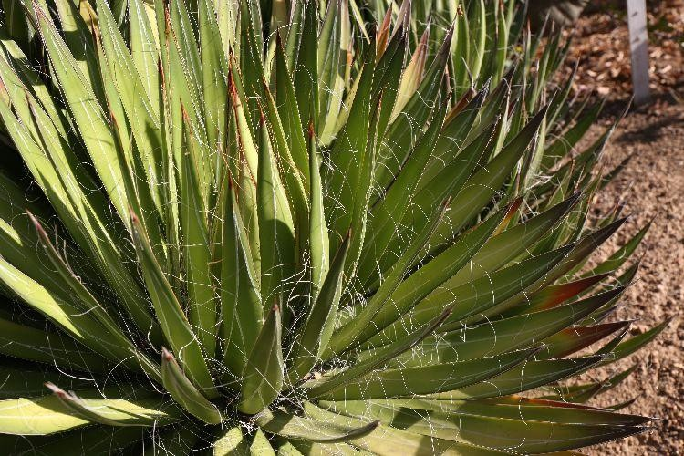

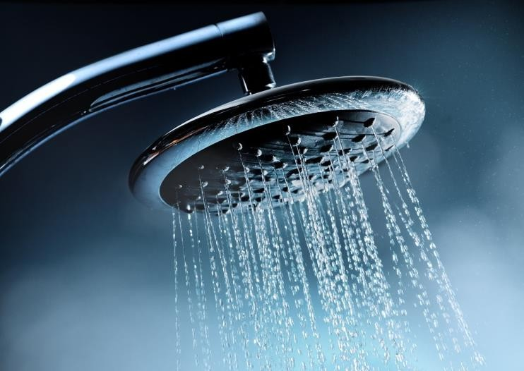
Action: Conservation
Urban
  Landscape rebates
  Irrigation guides
  Plumbing fixtures
  Education/workshops
400
Sources: “Demand” from Historical MCSB Pumping Data;
“Population” from 2013 WMP and SCAG TAZ Data
Water Usage (Demand/Population, GPCD)
350
300
250
200
150
100
50
0
1980
1985
1990
1995
2000
2005
2010
2015
2020

Slide 70
What Does a Groundwater Sustainability Agency (GSA) Do?
Responsible for achieving sustainable groundwater management within their boundaries
A GSA, or multiple GSAs, are responsible for:
  Submitting Groundwater Sustainability Plans (GSPs) or Alternative Plans
  Preparing Annual Reports and 5-Year Plan Updates
GSAs have many authorities and responsibilities, such as:
  Adopting rules, regulations, ordinances, and resolutions to implement the Act
  Monitoring compliance and enforcement
  Requiring registration of groundwater extraction wells
  Requiring appropriate measurement devices and reporting of extractions

Slide 71
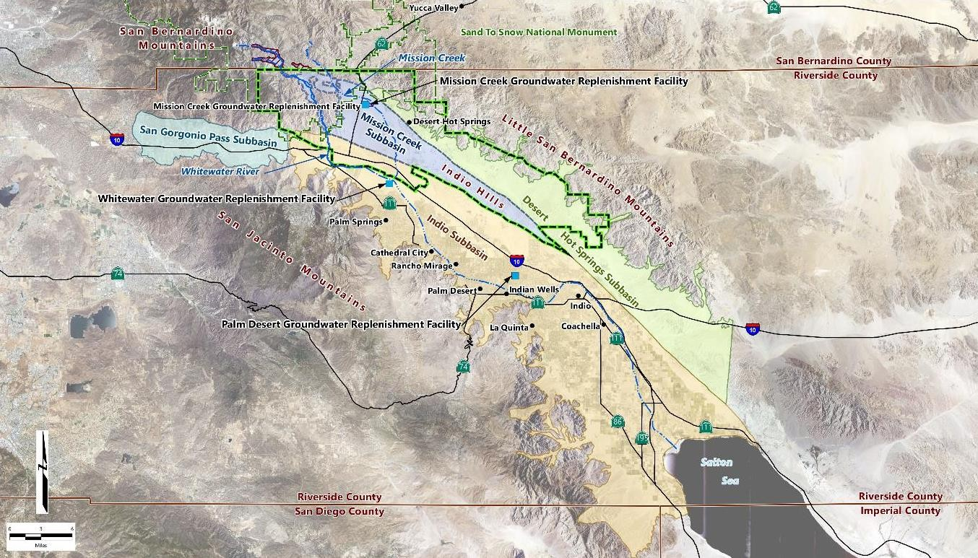
Mission Creek Subbasin and SGMA – Context
Mission Creek Subbasin designated as medium priority
San Gorgonio Pass Subbasin designated as medium priority; Periodic Evaluation is underway
Desert Hot Springs Subbasin designated as very low-priority; water supply provided by MCSB and Indio Subbasin
Indio Subbasin designated as medium priority; Alternative Plan being updated
The MCSB is one of many subbasins in the Coachella Valley Groundwater Basin

Slide 72
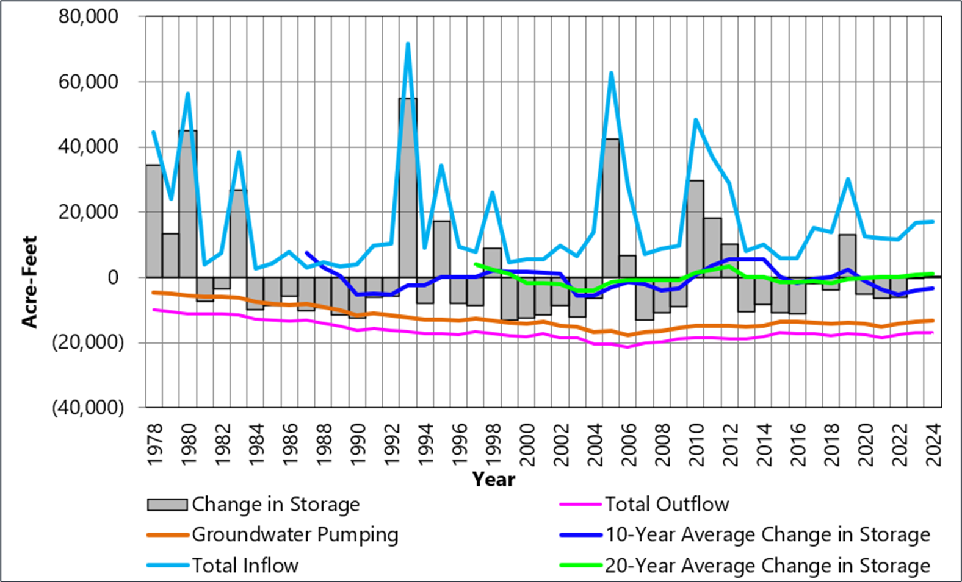
Recent History of Water Management
Managing a groundwater basin is like managing a checking account, for long-term sustainability, what comes in has to balance with what goes out
Water levels reflect groundwater storage in the basin (storage)

Slide 73

2022 Alternative Plan Update
Built on Existing Management Plan + Bridge Document for SGMA Compliance
          Established sustainable management criteria including “Key Wells”
          Updated the MCSB groundwater model
          Assessed growth and land use
    Estimated future supply/demand
    Forecast future water levels with the groundwater model
    Identified management actions needed to meet demands
    Concluded that the MCSB was currently and would continue to operate sustainably with the proposed management plan
Updating the Alternative Plan Update

Slide 74
Sustainable Management Criteria - Interconnected Surface Water
No connected surface waters near known groundwater pumping in the MCSB.
Although not a related to Interconnected Surface Water, the mesquite hummocks are a known groundwater dependent ecosystem.
It is unclear which factors impact mesquite health: Urban encroachment, non-native tamarisk trees as competitors, groundwater levels, unique fault conditions, drought, climate change, or a combination of these factors
Further study is needed, including continued planned monitoring
Source: 2022-2023 Engineer's Report on Water Supply and Replenishment Assessment, April 2022
Notes:
978

Slide 75
Water Balance and Change in Storage
Water balance compares inflows and outflows. A negative water balance results in decreasing water levels and negative storage and a positive water balance results in increasing water levels and positive storage
Fluctuations are expected but the long-term average should be near zero
Source: Mission Creek Subbasin Annual Report for WY 2023-2024
Notes:
FINAL MCSB Annual Report for WY 2023-2024.pdf

Slide 76

Water Levels in Water Year 2023-2024
Water levels in Key Wells were above the Measurable Objective in all but one Key Well
The Key Well with water levels near the Minimum Threshold was a provisional setting that will be reevaluated
GW- Groundwater*
Source: Mission Creek Subbasin Annual Report for WY 2023-2024
Notes:
FINAL MCSB Annual Report for WY 2023-2024.pdf

Slide 77


Is the Alternative Plan Working?
Groundwater Levels and Change in Storage 2009 to 2019
Source: Mission Creek Subbasin Annual Report for WY 2018-2019
34
Notes:
Need Help making this graphic for the most updated area: pg. 91 in FINAL MCSB Annual Report for WY 2023-2024.pdf
Notes:
Groundwater levels/groundwater storage have increased in the MCSB over the last 10 years
Plan projects future growth and identifies strategies for meeting future and current needs
More work to be done to ensure the continued success of the Plan

Slide 78
Tasks to Prepare the 2027 Alternative Plan Update
Assess the existing Alternative Plan
Update and process current datasets
Research and document current groundwater conditions
Estimate future water demand and supplies
Evaluate management actions and check if new actions should be considered
Update implementation plan
Simulate groundwater response to future conditions using a model
Establish quantifiable sustainability goals and criteria
Assess data collection/monitoring programs
Develop and implement stakeholder and public outreach plan

